Slide 1
JavaScript EcmaScript2015
By Yuliia Tsurkan

Slide 2


Slide 3
Babel
We will be using Babel (babeljs.io) to convert new JavaScript to ES5.
To install it:
  npm install --save-dev babel-cli babel-preset-env
Create file .babelrc
  {
  "presets": ["env"]
  }
Add entry to "scripts" section of package.json file:
  "babel": "babel src -d dist"
To run transpilation process use the following command:
  npm run babel

Slide 4
src/sample.js:
const message = `Hello World`;
console.log(message);
npm run babel
dist/sample.js:
"use strict";
var message = "Hello World";
console.log(message);

Slide 5
var vs let / const
In ES6, you can additionally declare variables via let and const. Such variables are block-scoped ( ...{ } ), their scopes are the innermost enclosing blocks. let is roughly a block-scoped version of var. const works like let, but creates variables whose values can’t be changed.
Best Practice:
Use const by default.
Use let if you have to rebind a variable.
Avoid var.

Slide 6
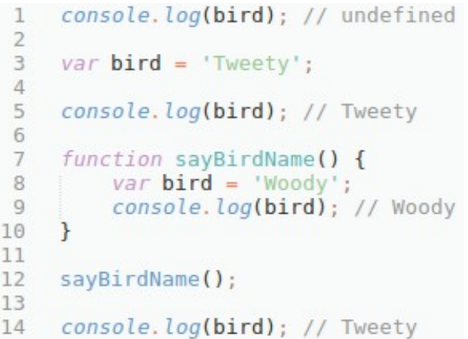
HOISTING
Hoisting is a JavaScript mechanism where variables and function declarations are moved to the top of their scope before code execution.

Slide 7
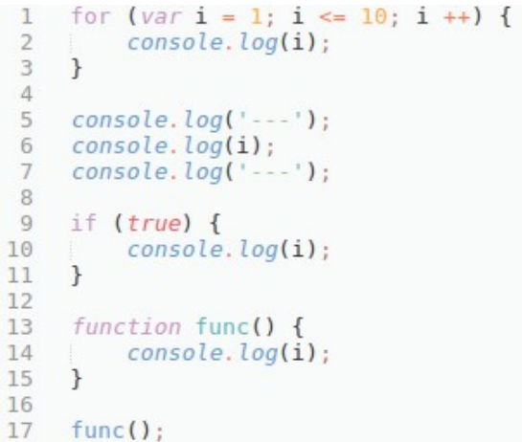
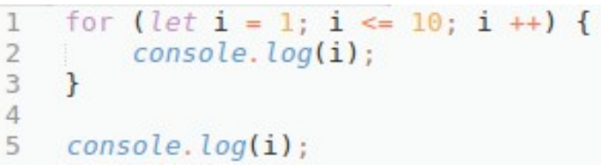

Slide 8
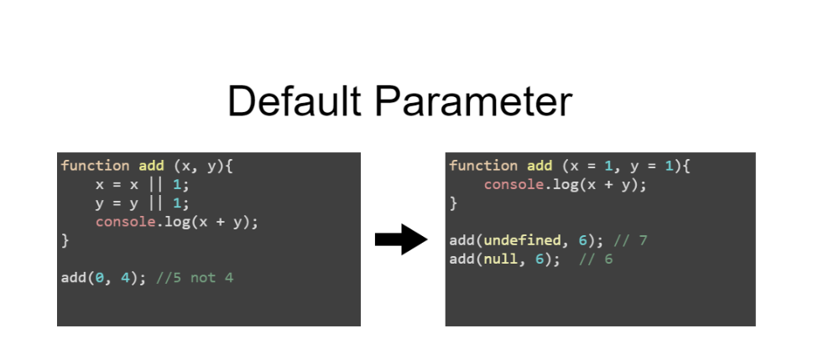

Slide 9
Template Literals
Template literals are string literals that can be multi-line and allow embedded expressions.
They are enclosed by the back-tick (` ) (grave accent) character instead of double or single quotes.
Multi-line template literal
const markup = `<h1>Multi-line</h1>
<p>template literal</p>`;
Template literal with expressions
const name = 'John';
const age = 42;
console.log(`Hello ${name}, soon you will be ${age + 1}`);
// Hello John, soon you will be 43

Slide 10
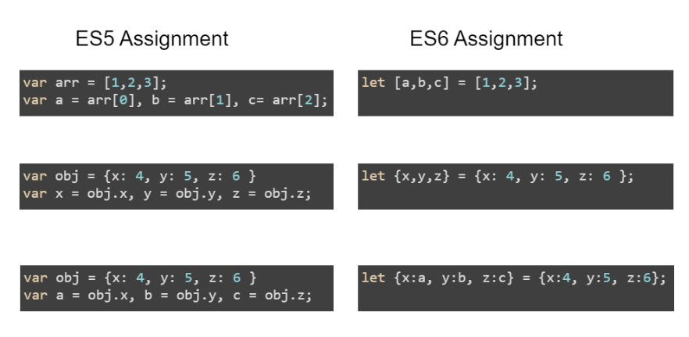
Destructuring Assignment

Slide 11
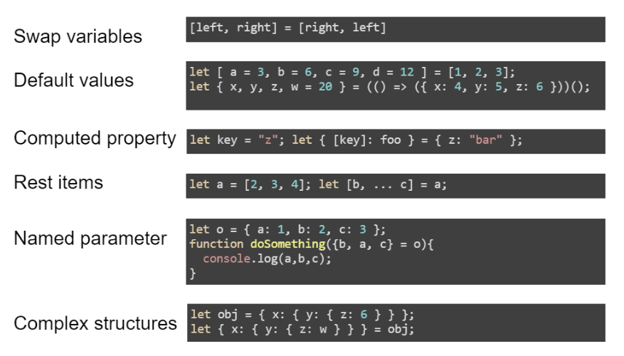

Slide 12
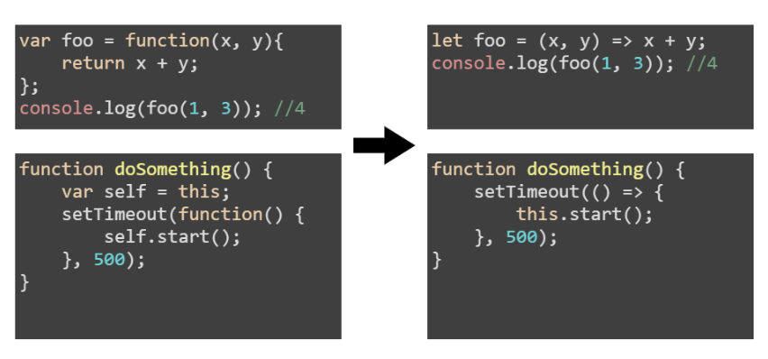
Arrow functions

Slide 13
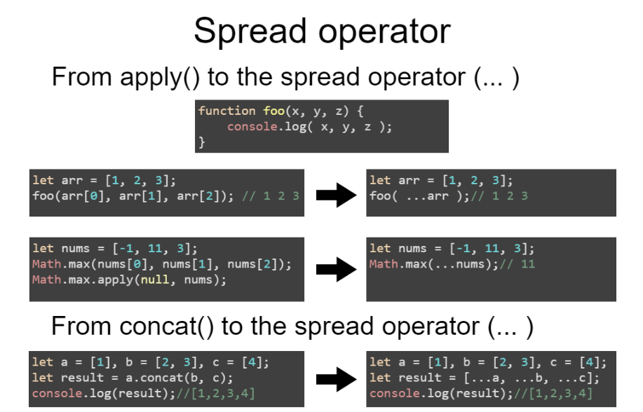

Slide 14
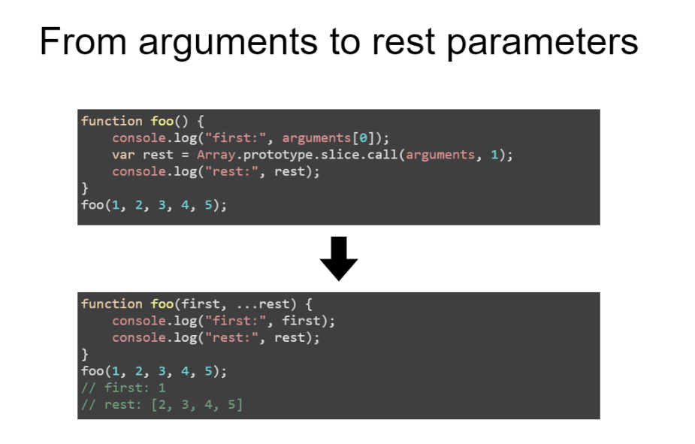

Slide 15
Symbol type
A symbol is a unique and immutable data type and may be used as an identifier for object properties.
Syntax:
  Symbol([description])
To create a new primitive symbol, you write Symbol() with an optional string as its description.
const sym1 = Symbol();
const sym2 = Symbol("foo");
const sym3 = Symbol("foo");
Symbol("foo") === Symbol("foo"); // false
The following syntax with the new operator will throw a TypeError:
var sym = new Symbol(); // TypeError

Slide 16
Global Symbol Registry
To create global symbols, use the methods Symbol.for() and Symbol.keyFor() to set and retrieve symbols from the global symbol registry.
Symbol('foo') !== Symbol('foo'); // local symbols are unique
Symbol.for('foo') === Symbol.for('foo'); // global symbols are identical
// Using symbols as object keys
var someObj = {};
var fooSym = Symbol.for('foo');
var otherSym = Symbol.for('foo');
someObj[fooSym] = 'some value';
someObj[otherSym] = 'other value';
fooSym === otherSym; // same symbols because they are global
someObj[fooSym] === 'other value'; // same symbols behave as same keys
someObj[otherSym] === 'other value';

Slide 17
Classes
EcmaScript 2015 standard introduces classes but they are actually syntax sugar over well-known constructor functions and do not change prototyping inheritance built-in into the language.
To declare a class, you use the class keyword with the name of the class.
An important difference between function declarations and class declarations is that function declarations are hoisted and class declarations are not. You first need to declare your class and then access it, otherwise you get ReferenceError.

Slide 18
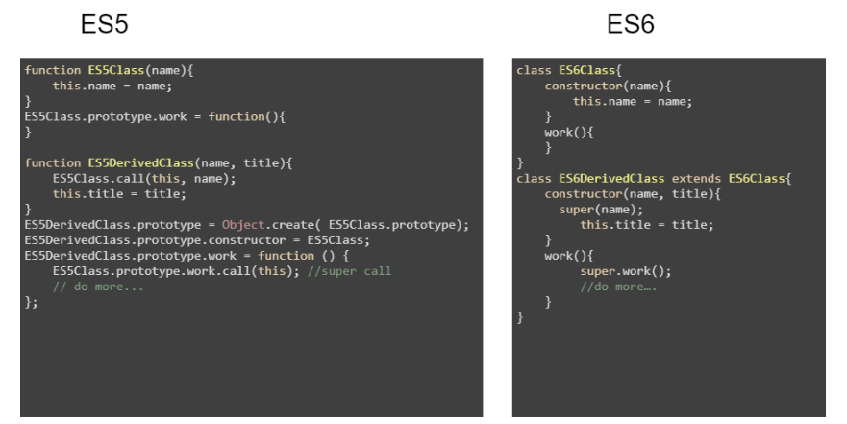

Slide 19
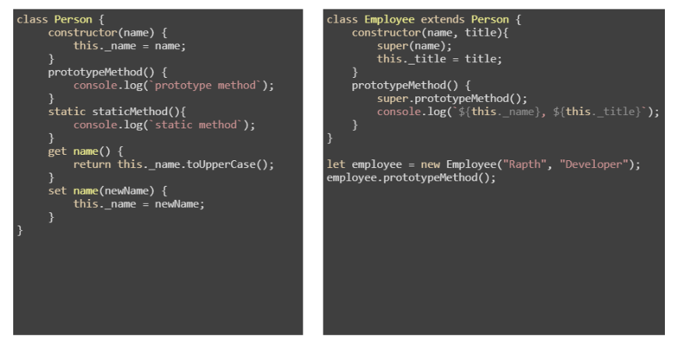

Slide 20
Modules
EcmaScript 2015 introduces language-level support for modules that contains definition of components.
Modules use implicitly asynchronous model – no code executes until requested modules are called from code.
Module should export entities that can be functions, object or primitives with keyword export. Default entity that can be one per module should be marked with keyword default.
To import from module we should use keyword import.

Slide 21
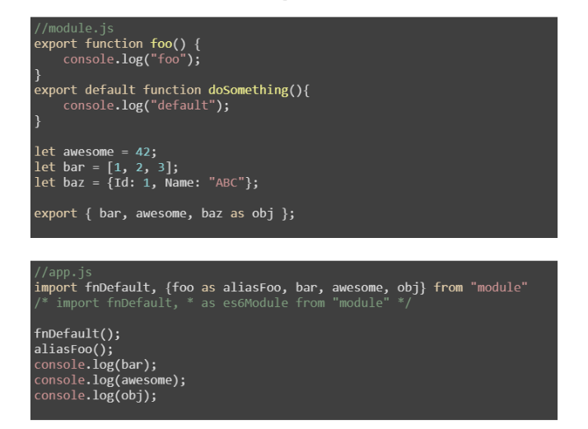

Slide 22
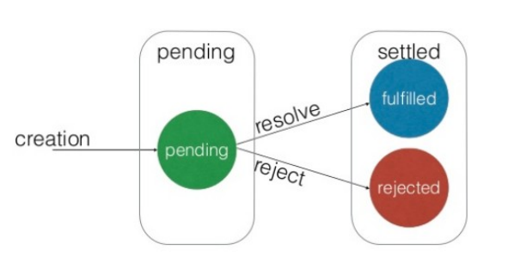
Promise
Promises are immutable
- they are either kept or broken;
- when a promise is kept, we are guaranteed to receive a value;
- when a promise is broken, we are guaranteed to receive a reason (error);

Slide 23
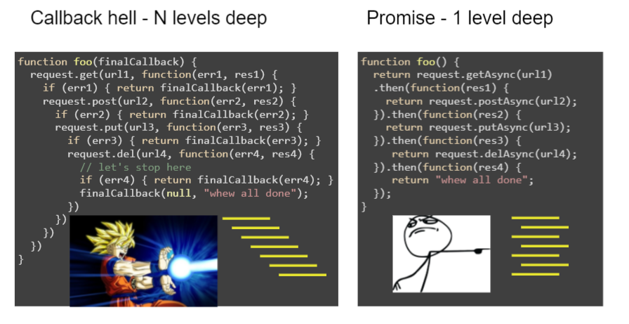

Slide 24
Loop
const array1 = ['a', 'b', 'c'];
for (const element of array1) {
console.log(element);
}
// expected output: "a“
// expected output: "b“
// expected output: "c"
const obj = {a:1, b:2, c:3};
for (const key in obj) {
console.log(`obj.${key} = ${obj[key]}`)
}
// "obj.a = 1"
// "obj.b = 2"
// "obj.c = 3"
forEach() — executes a provided function once for each array element.
map() — creates a new array with the results of calling a provided function on every element in the calling array.

Slide 25


